Slide 1

The Heart that follows Jesus

Slide 2
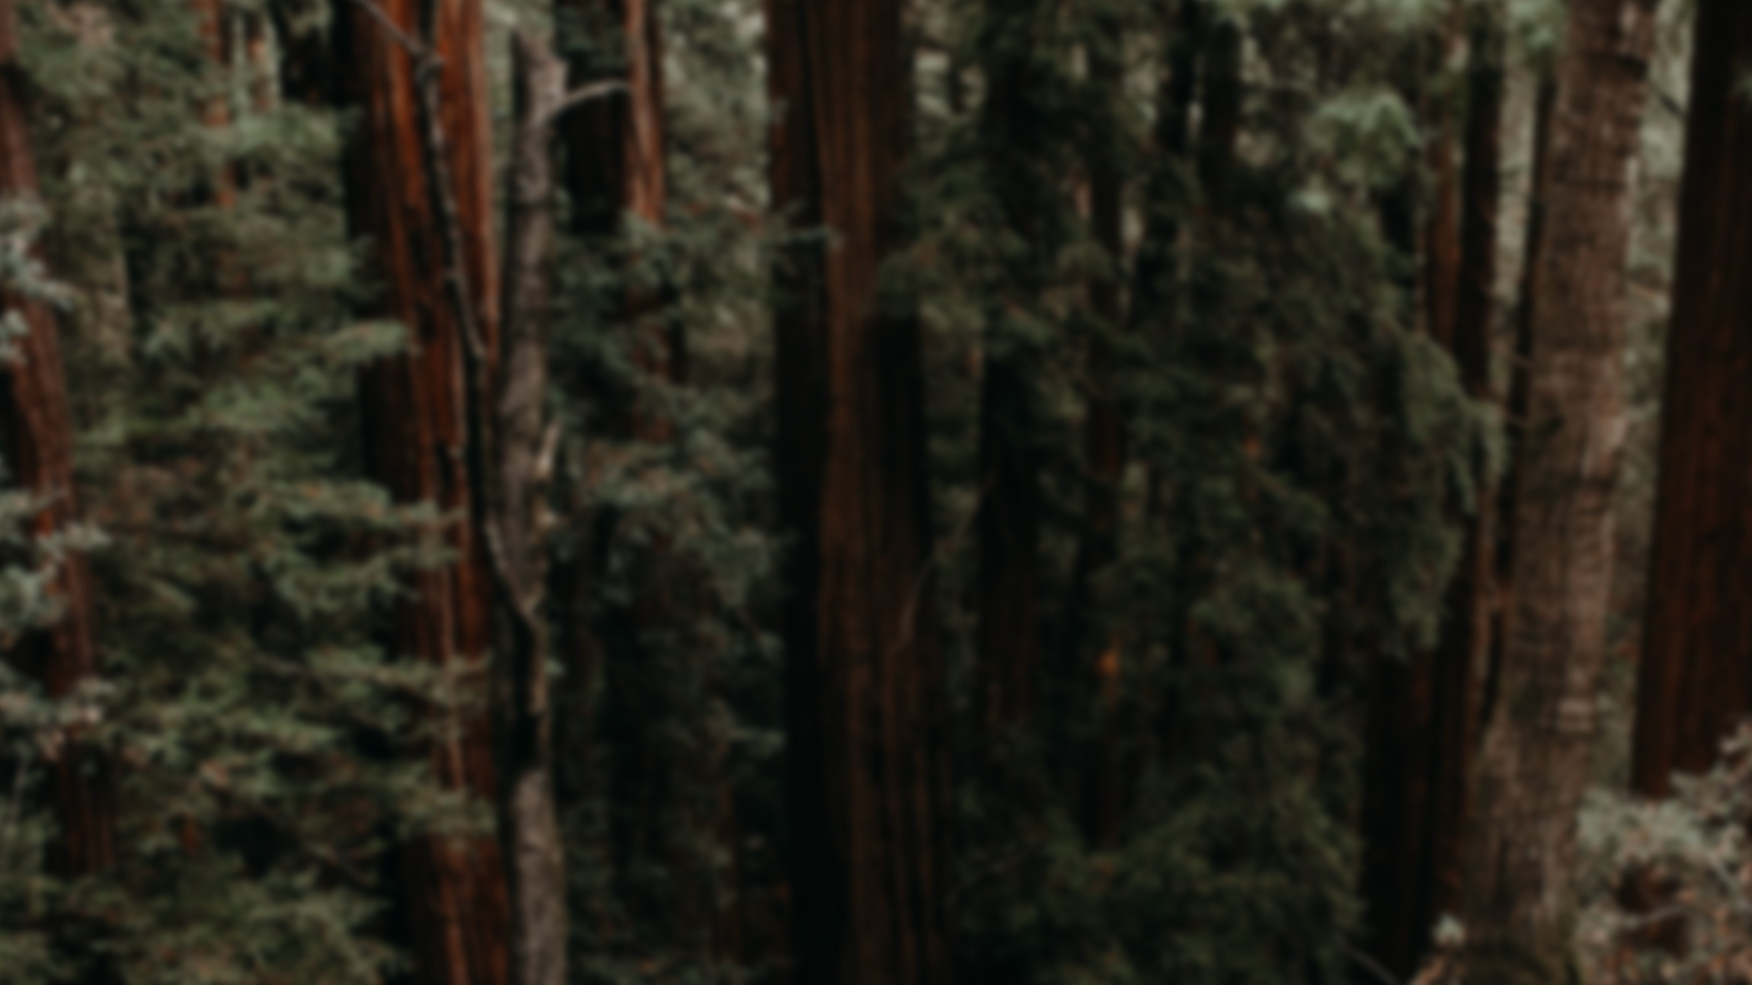
(Phil 3:1-17) ¹Finally, my brothers, rejoice in the Lord. To write the same things to you is no trouble to me and is safe for you.²Look out for the dogs, look out for the evildoers, look out for those who mutilate the flesh. ³For we are the circumcision, who worship by the Spirit of God and glory in Christ Jesus and put no confidence in the flesh

Slide 3
(Phil 3) ⁴ though I myself have reason for confidence in the flesh also. If anyone else thinks he has reason for confidence in the flesh, I have more: ⁵circumcised on the eighth day, of the people of Israel, of the tribe of Benjamin, a Hebrew of Hebrews; ⁶as to the law, a Pharisee; as to zeal, a persecutor of the church; as to righteousness under the law, blameless.

Slide 4
(Phil 3:1-17)⁷ But whatever gain I had, I counted as loss for the sake of Christ. ⁸Indeed, I count everything as loss because of the surpassing worth of knowing Christ Jesus my Lord. For his sake I have suffered the loss of all things and count them as rubbish, in order that I may gain Christ ⁹and be found in him,

Slide 5
(Phil 31:1-17) not having a righteousness of my own that comes from the law, but that which comes through faith in Christ, the righteousness from God that depends on faith ¹⁰that I may know him and the power of his resurrection, and may share his sufferings, becoming like him in his death,

Slide 6
(Phil 3:1-17)¹¹ that by any means possible I may attain the resurrection from the dead.¹² Not that I have already obtained this or am already perfect, but I press on to make it my own, because Christ Jesus has made me his own. ¹³Brothers, I do not consider that I have made it my own. But one thing I do:

Slide 7
(Phil 3:1-17) forgetting what lies behind and straining forward to what lies ahead, ¹⁴ I press on toward the goal for the prize of the upward call of God in Christ Jesus. ¹⁵ Let those of us who are mature think this way, and if in anything you think otherwise, God will reveal that also to you.

Slide 8
(Phil 3:1-17)¹⁶ Only let us hold true to what we have attained. ¹⁷ Brothers, join in imitating me, and keep your eyes on those who walk according to the example you have in us.

Slide 9
(Phil 3:1-17) ²Look out for the dogs, look out for the evildoers, look out for those who mutilate the flesh. ³For we are the circumcision, who worship by the Spirit of God and glory in Christ Jesus and put no confidence in the flesh

Slide 10
(Phil 3:1-17)⁷ But whatever gain I had, I counted as loss for the sake of Christ. ⁸Indeed, I count everything as loss because of the surpassing worth of knowing Christ Jesus my Lord. For his sake I have suffered the loss of all things and count them as rubbish, in order that I may gain Christ ⁹and be found in him,

Slide 11
(Phil 31:1-17) ⁹ and be found in him, not having a righteousness of my own that comes from the law, but that which comes through faith in Christ, the righteousness from God that depends on faith

Slide 12
The Heart that follows Jesus
The heart that follows Jesus knows that without Jesus everything is worthless.

Slide 13
(Phil 3:10) ¹⁰ that I may know him and the power of his resurrection, and may share his sufferings, becoming like him in his death, ¹¹ that by any means possible I may attain the resurrection from the dead.

Slide 14
(2 Pet 1:3) His divine power has granted to us all things that pertain to life and godliness, through the knowledge of him who called us to his own glory and excellence,
(1 John 2:6) whoever says he abides in him ought to walk in the same way in which he walked.

Slide 15
The Heart that follows Jesus
The heart that follows Jesus knows that without Jesus everything is worthless.
The heart that follows Jesus has a desire to know Him and become like Him.

Slide 16
(Phil 3:1-17)¹³ Brothers, I do not consider that I have made it my own. But one thing I do:forgetting what lies behind and straining forward to what lies ahead, ¹⁴ I press on toward the goal for the prize of the upward call of God in Christ Jesus. ¹⁵ Let those of us who are mature think this way, and if in anything you think otherwise, God will reveal that also to you.

Slide 18
The Heart that follows Jesus
The heart that follows Jesus knows that without Jesus everything is worthless.
The heart that follows Jesus has a desire to know Him and become like Him.
The heart that follows Jesus does so out of a place of acceptance.

Slide 19
(Phil 3:12) Not that I have already obtained this or am already perfect, but I press on to make it my own, because Christ Jesus has made me his own.

Slide 20
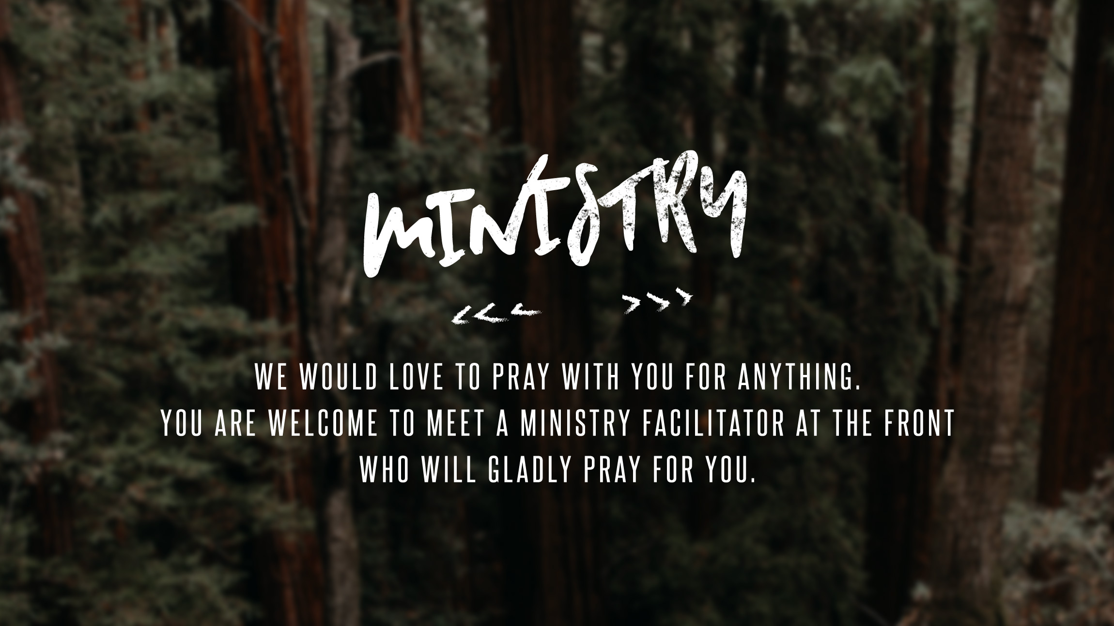

Slide 21


Slide 22


Slide 23
