Slide 1
Titus 1:1-4
Part 2: God our Savior

Slide 2
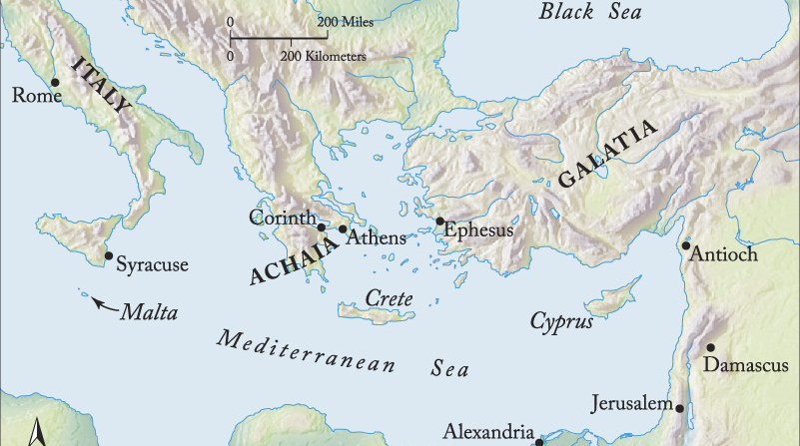
Titus 1:1-4
Servants of God
Caption

Slide 3
Servants of God
We are all called to be servants and messengers of God.
The reason for our mission is to love the people of God.
We should set our hope fully on eternity.

Slide 4
Titus 1:1-4 (ESV)
¹Paul, a servant of God and an apostle of Jesus Christ, for the sake of the faith of God’s elect and their knowledge of the truth, which accords with godliness, ² in hope of eternal life, which God, who never lies, promised before the ages began

Slide 5
Titus 1:1-4 (ESV)
³ and at the proper time manifested in his word through the preaching with which I have been entrusted by the command of God our Savior; ⁴ To Titus, my true child in a common faith: Grace and peace from God the Father and Christ Jesus our Savior.

Slide 6
Titus 1:3-4 (ESV)
³ and at the proper time manifested in his word through the preaching with which I have been entrusted by the command of God our Savior; ⁴ To Titus, my true child in a common faith: Grace and peace from God the Father and Christ Jesus our Savior.

Slide 7
Titus 1:3-4 (ESV)
³ and at the proper time manifested in his word through the preaching with which I have been entrusted by the command of God our Savior; ⁴ To Titus, my true child in a common faith: Grace and peace from God the Father and Christ Jesus our Savior.

Slide 8
Entrusted with the Gospel by God our Savior
Now is the proper time for all God’s people to proclaim the Gospel

Slide 9
Titus 1:3-4 (ESV)
³ and at the proper time manifested in his word through the preaching with which I have been entrusted by the command of God our Savior; ⁴ To Titus, my true child in a common faith: Grace and peace from God the Father and Christ Jesus our Savior.

Slide 10
Entrusted with the Gospel by God our Savior
Now is the proper time for all God’s people to proclaim the Gospel
Saving Grace produces joyful obedience.

Slide 11
Titus 1:3-4 (ESV)
³ and at the proper time manifested in his word through the preaching with which I have been entrusted by the command of God our Savior; ⁴ To Titus, my true child in a common faith: Grace and peace from God the Father and Christ Jesus our Savior.

Slide 12
Entrusted with the Gospel by God our Savior
Now is the proper time for all God’s people to proclaim the Gospel
Saving Grace produces joyful obedience.
Christianity is fundamentally communal.

Slide 13
Titus 1:3-4 (ESV)
³ and at the proper time manifested in his word through the preaching with which I have been entrusted by the command of God our Savior; ⁴ To Titus, my true child in a common faith: Grace and peace from God the Father and Christ Jesus our Savior.

Slide 14
Entrusted with the Gospel by God our Savior
Now is the proper time for all God’s people to proclaim the Gospel
Saving Grace produces joyful obedience.
Christianity is fundamentally communal.
Every word of Scripture is grace to us, and when obeyed produces peace in us.

Slide 15
Entrusted with the Gospel by God our Savior
Does your obedience to God feel like duty or delight?
Do you see your Christianity as fundamentally communal?
Action Piont
Invite someone in church for dinner that you haven’t before.

