Slide 1
Titus 1:1-4
Part 1:Servants of God

Slide 2
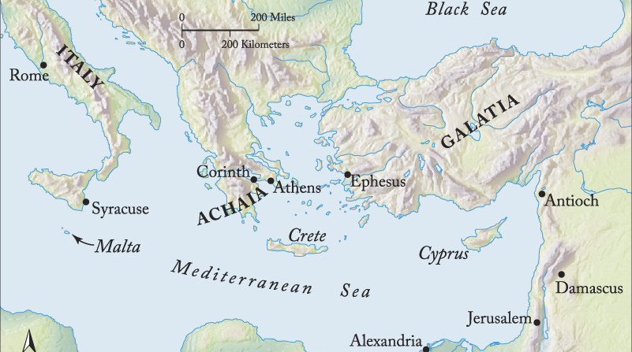
Titus 1:1-4
Servants of God
Caption

Slide 3
Titus 1:1-4 (ESV)
¹Paul, a servant of God and an apostle of Jesus Christ, for the sake of the faith of God’s elect and their knowledge of the truth, which accords with godliness, ² in hope of eternal life, which God, who never lies, promised before the ages began

Slide 4
Titus 1:1-4 (ESV)
³ and at the proper time manifested in his word through the preaching with which I have been entrusted by the command of God our Savior; ⁴ To Titus, my true child in a common faith: Grace and peace from God the Father and Christ Jesus our Savior.

Slide 5
Titus 1:1-2 (ESV)
¹Paul, a servant of God and an apostle of Jesus Christ, for the sake of the faith of God’s elect and their knowledge of the truth, which accords with godliness, ² in hope of eternal life, which God, who never lies, promised before the ages began

Slide 6
Servants of God
We are all called to be servants and messengers of God.

Slide 7
Titus 1:1-2 (ESV)
¹Paul, a servant of God and an apostle of Jesus Christ, for the sake of the faith of God’s elect and their knowledge of the truth, which accords with godliness, ² in hope of eternal life, which God, who never lies, promised before the ages began

Slide 8
Servants of God
We are all called to be servants and messengers of God.
The reason for our mission is to love the people of God.

Slide 9
Titus 1:1-2 (ESV)
¹Paul, a servant of God and an apostle of Jesus Christ, for the sake of the faith of God’s elect and their knowledge of the truth, which accords with godliness, ² in hope of eternal life, which God, who never lies, promised before the ages began

Slide 10
Servants of God
We are all called to be servants and messengers of God.
The reason for our mission is to love the people of God.
We should set our hope fully on eternity.

Slide 11
Servants of God
Do you have the mindset of being a slave of God?
Do you see your Christianity as fundamentally communal?
Action Piont
Make time this week to pray about being a servant and messengers of God.

