Slide 1
2 Tim 2:14-19
Present yourself to God as one approved
The Holy Bible: English Standard Version (Wheaton, IL: Crossway Bibles, 2016), 2 Ti 2:15.

Slide 2
2 Tim 2:14-19 (ESV)
¹⁴ Remind them of these things, and charge them before God not to quarrel about words, which does no good, but only ruins the hearers. ¹⁵ Do your best to present yourself to God as one approved, a worker who has no need to be ashamed, rightly handling the word of truth.¹⁶ But avoid irreverent babble, for it will lead people into more and more ungodliness,
Caption

Slide 3
2 Tim 2:14-19 (ESV)
¹⁷ and their talk will spread like gangrene. Among them are Hymenaeus and Philetus, ¹⁸ who have swerved from the truth, saying that the resurrection has already happened. They are upsetting the faith of some. ¹⁹ But God’s firm foundation stands, bearing this seal: “The Lord knows those who are his,” and, “Let everyone who names the name of the Lord depart from iniquity.
Caption

Slide 4
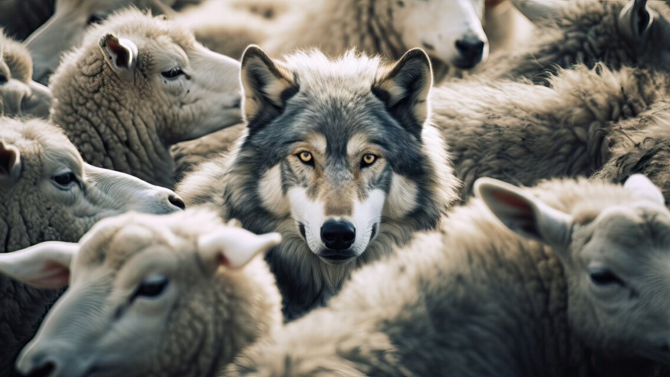
Caption
Caption

Slide 5
2 Tim 2:14(ESV)
¹⁴ Remind them of these things, and charge them before God not to quarrel about words, which does no good, but only ruins the hearers.
Caption

Slide 6
Present yourself to God as one approved
Avoid getting distracted from focusing on the Truth.
Caption

Slide 7
2 Tim 2:15-16 (ESV)
¹⁵ Do your best to present yourself to God as one approved, a worker who has no need to be ashamed, rightly handling the word of truth.¹⁶ But avoid irreverent babble, for it will lead people into more and more ungodliness,
Caption

Slide 8
Present yourself to God as one approved
Avoid getting distracted from focusing on the Truth.
Do you best to understand and apply the Gospel.
Caption

Slide 9
Acts 20:31-32 (ESV)
³¹ Therefore be alert, remembering that for three years I did not cease night or day to admonish every one with tears. ³² And now I commend you to God and to the word of his grace, which is able to build you up and to give you the inheritance among all those who are sanctified.
Caption

Slide 10
Present yourself to God as one approved
Are you engaging in meaningless quarrels and irreverent babble?
Are you doing your best to present yourself to God as one approved, rightly handeling to word of Truth?
Caption

